Slide 1
Agile Product Management – Portfolio Focus

Slide 2
MIDTERM
Feedbackl

Slide 3
OK, LETS GET TO IT!!!
Self organize yourselves into SCRUM teams and produce a one page paper detailing the similarities and differences that the main characters from Jane Eyre and Lara Croft face with respect to their traditional societal and economic expectations of the time period in which their stories take place.

Slide 4
What is wrong with my offering this to you?
Self organize yourselves into SCRUM teams and produce a one page paper detailing the similarities and differences that the main characters from Jane Eyre and Lara Croft face with respect to their traditional societal and economic expectations of the time period in which their stories take place.

Slide 5
Today’s Class
Agile Product Management with a focus on Product Portfolio
Discuss Agile product development approach
Understand the benefits of having a vision for a product for Agile teams
EXERCISE – Building a vision Statement
Explore the value of Personas for product development and agile teams
Exercise – Identifying and creating Personas
Investigate how a tiered product portfolio helps companies with lean agile orientated product development towards their customers
Exercise – Create a Product Vision Box to bring Vision, Persona, Outcomes, and Outputs together

Slide 6
Product Management vs. Product Development
Product Management
Roadmap
Customer Understanding
Pricing
Marketing
Product Development
Building
Prototyping
Operationalization
Sustainability

Slide 7
Agile Product Management Requires Collaboration
UX
TECH
BUSINESS
Measures the opportunity and potential viability for product enhancement against other factors that are significant to the company
Sustainable enhancement & “operationizing” the product with opportunities for innovation and efficiency
“User Experience is any way that customers and end-users realize the value provided by your product. It includes all the touchpoints and interactions a customer has with your company and product over time. ”*
Agile Product Management
* Source: Marty Cagan – Silicon Valley Product Group

Slide 8
Agile Teams are Product Focused NOT Project Focused
Product Focus Teams
Customer Embracing
Inspired by a Vision
Fulfilling Outcomes
Experimenting with Outputs
Deploy when ready
Stable and sustainable membership
Work comes to them
Project Focus Teams
Requirement Embracing
Inspired by completeness
Fulfilling Requirements
Deliver to spec
Individuals over teams
Shift staff to need rather opportunities to teams

Slide 9
Product Vision
It’s primary purpose is to communicate this vision and inspire the teams (and investors and partners) to want to help make this vision a reality.
A good vision statement will normally address these 5 Questions:
Who will buy the product? (Target customer)
Which customer needs will be addressed?
What are the critical attributes for success?
How does it compare against existing products? What are its unique selling points?
What is the target timeframe and budget?

Slide 10
Benefits of a Product Vision Statement
A good Product Vision aids:
Providing agile teams with focus, meaning and purpose
Clarification for target customers/users
Guide in the development of a 12-24 month RoadMap of Enhancements
Creation and organization of product backlog
Help form consensus on the products Next Viable Deployment – NVD
What is the next capability we can provide to our customer to determine if it meets their needs?
Eric Ries (author of The LeanStartUp) describes as “smallest possible experiment to test a specific hypothesis”
Many use the term MVP’s (a.k.a “minimum viable product”)
Problem with MVP is that can be vague and not small at all

Slide 11
Class Exercise
CREATE A PRODUCT VISION

Slide 12
PERSONAS

Slide 13
Who Is This Product For?
Personas are a popular aid to understanding customers and their needs for various areas of an organization
Common elements of a persona
Name & Picture
Organizational or system role
Relevant characteristics that effect use of the product
Needs the product addresses
AVOID STEROTYPE or BIAS ATTRIBUTES TOWARDS THE PERSONA
Question each attribute to determine if it really causes the persona to interface with your product in a different way. (i.e., does level of education really matter?)
Notes:
Clarify the wording of the bullets

Slide 14
Benefits of Personas
Personas help stakeholders and development teams:
Empathize with the Customer
Provides consensus on target customer needs across an organization
Shorten the distance between the product development team and the Customer
Evaluate the benefit of new features
Determine the best way to meet a user’s need
Create UX experiences that match the user’s expectations
Aides in prioritization Discussions of Initiatives, Features, User Stories

Slide 15
Creating Personas
Usability.gov recommends the following steps for creating personas:
Conduct User Research
Focus groups, surveys, etc.
Condense the research
Look for high level themes
Brainstorm
Organize elements into persona groupings
Refine
Combine and prioritize rough personas
3-5 personas is considered ideal
Make them realistic
https://www.usability.gov/how-to-and-tools/methods/personas.html

Slide 16
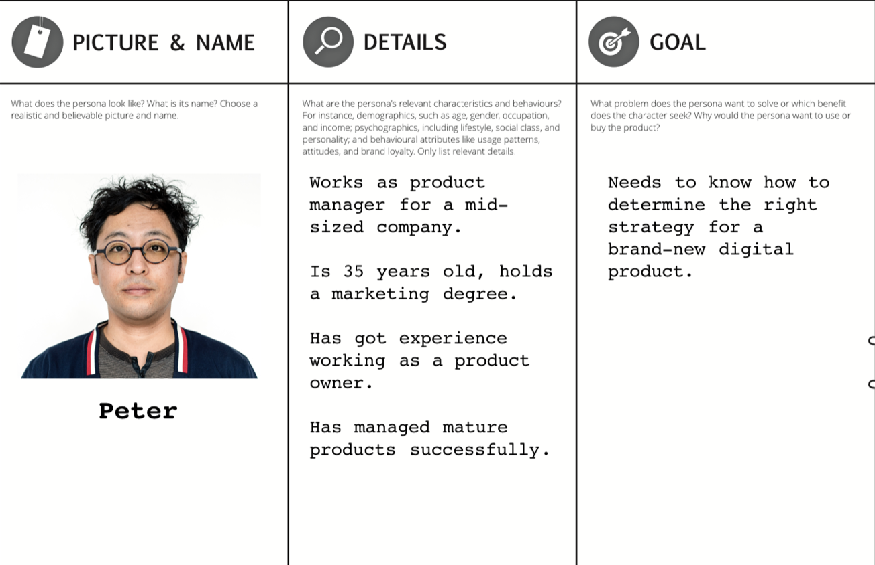
Persona Samples
Source Fackcrow.com
Source Roman Pilcher

Slide 17
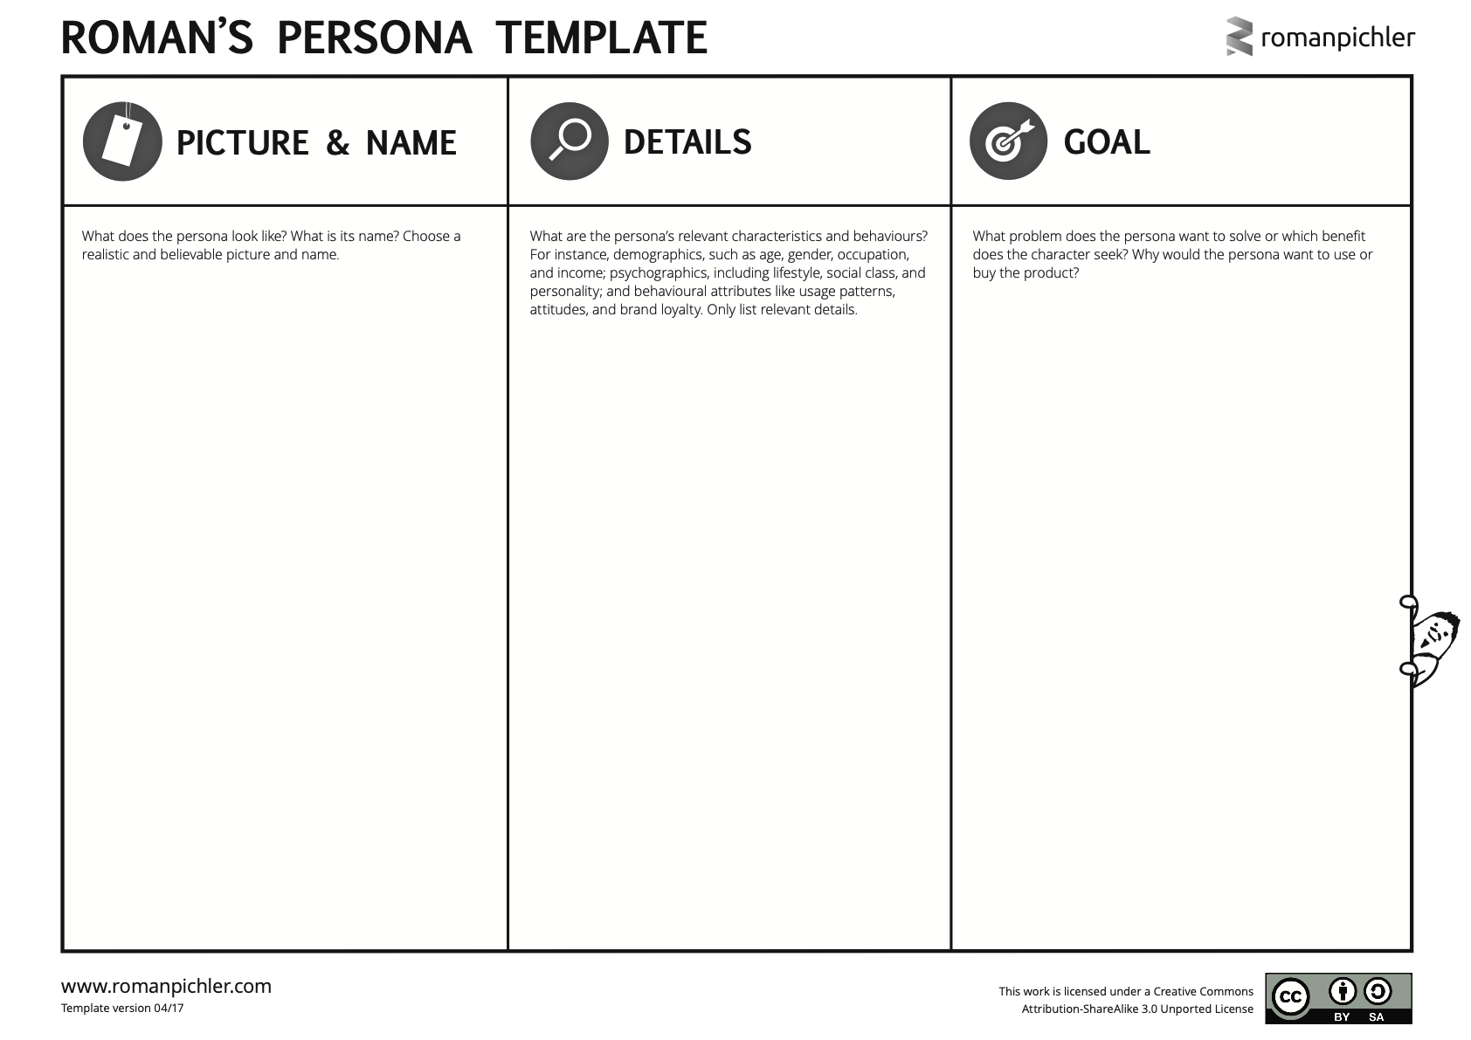

Slide 18
Class Exercise
CREATE PERSONAS

Slide 19
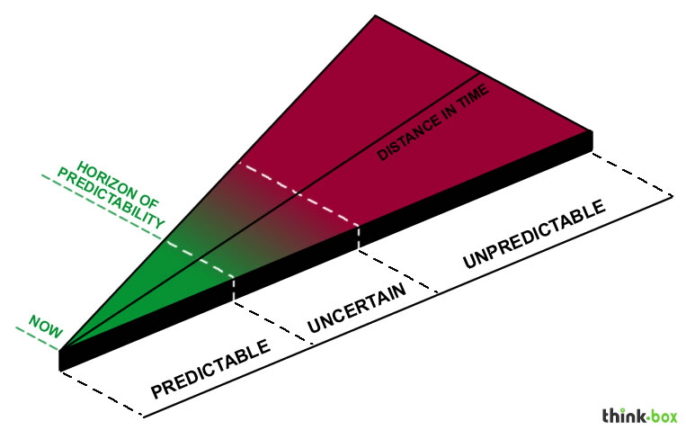
Agile Product Management Recognizes an Unpredictable and Changing Future
Horizon of Predictability
Items that occur farther away in the time horizon are less predictable
Agile methods attempt to correlate importance and effort with immediacy
Items farther away
Are less detailed
Change more frequently
Should consume less of the development team’s time

Slide 20
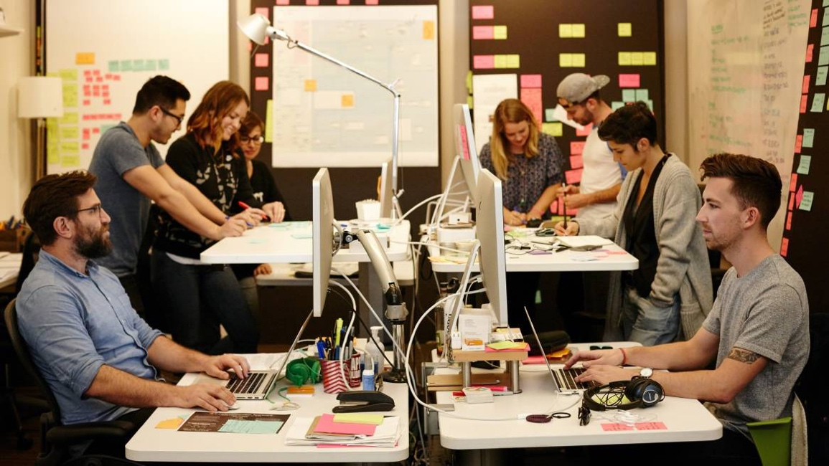
Product Ideation
Product Prioritization
Product
Creation

Slide 21
Idea
Production
Prioritize
PRODUCT PORTFOLIO
PORTFOLIO
Theme/Strategy (vision)
Outcomes
Outcomes
Outputs
Outputs
Outputs
Outputs
Outputs
Outputs
Functionality
Functionality
Functionality
Functionality
Functionality
Functionality

Slide 22
Product Management by variable scope
Whatever is in the release will be of the highest value to the customer will be demonstrable to management the soonest and will HOPEFULLY be what the customer truly wants now.
Prioritized Backlog
(Features or User Stories)
Likelihood to reach the customer
Business Value
Critical
Definite
Very Likely
Likely
Very Important
Important
Maybe

Slide 23
Outcomes
Are conjectures on how the services, experienced through products, might customers value most. It is framed within the current Vision of the product.
It is targeting the real benefits to the customer,
It is describing a future state to be created.
EXAMPLES:
Allowing a customer to make a purchase with only one mouse click
Allowing customers to stream movies from their smart phone onto the screen of the seat in front of them

Slide 24
Outputs (features)
Are enhancements to the product which the customers will experience, which are intended to meet the purpose of the OUTCOME it is aligned to.
There can be several Outputs which seek to address incrementally the intended Outcome.
Outputs are what is released or deployed to the customer at a particular time
Outputs are built incrementally by adding small functionality (by way of User Stories) to the product
Outputs are completed when all the User Stories have reached a “DONE” state
EXAMPLES:
Modify view item page to show “One Click To Pay” button
Adjust credit validation process to support One Click Pay flow
Adjust screen menu to list compatible streaming smart phones
Include instruction option to screen mention to assist customers to screen from their phone

Slide 25
Class Exercise
PRODUCT VISION BOX
PRODUCT VISION in Action
OUTCOMES
OUTPUTS (features)

Slide 26
Next Weeks Class
Product Portfolio – Team Focus
Align Initiatives to Features to User Stories
Explore Tiered Product Owner Roles
Define Features
Learn how User Stories are essential and transcending for Agile organizations
Understand the purpose of Acceptance Criteria
Investigate how estimation is performed within Agile

Slide 27
Have a great week
and remember…
Think Lean,
Be
Agile!

